Slide 1
Galaxy Look-Alikes and the Expanding Universe
By: Han Bao, Eva Gjekmarkaj, Yining Han
With: Rupert Croft

Slide 2
Overview of the Presentation
Project Mission
Definitions
SDSS Data Collection
Data Structure and Sosie Principle
Clustering Methodology
Conclusion

Slide 3
Introduction & Background

Slide 4
Project Mission
How can we use spectrum and photometric data to identify galaxies that are apparently different but inherently the same?

Slide 5
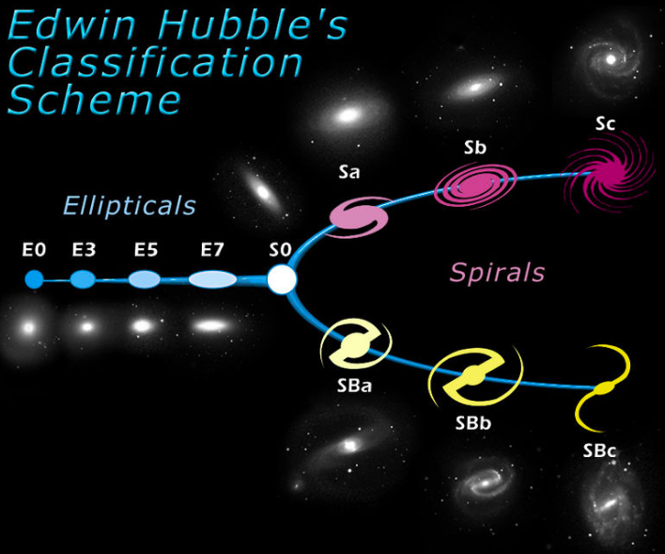
Previous Work
One of the features that previous papers used in identifying sosies was the morphological type classification.
Notes:
Morphological type

Slide 6
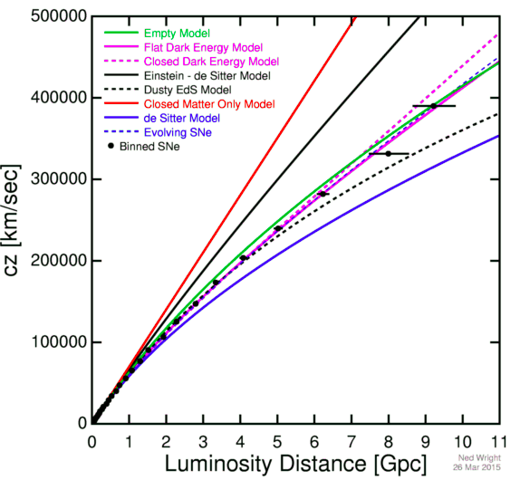
Cosmological Constant
This shows an accelerating Universe at low to moderate redshifts but a decelerating Universe at higher redshifts.
Notes:
Perhaps the emission lines are more important that u,g,r,iz ratios. We could rearrange these steps.

Slide 7
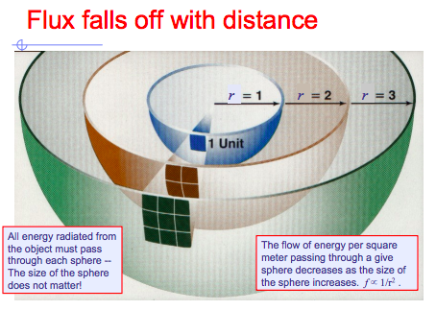
Flux and Luminosity
Luminosity - A star produces light
the total amount of energy that a star puts out as light each second is called its luminosity
With a detector, we can measure the light produced by the star - the total amount of energy intercepted by the detector (divided by the area of the detector) is called the flux.

Slide 8
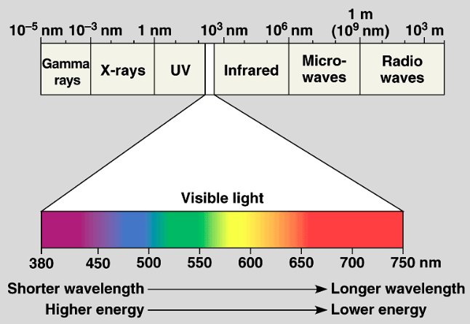
Wavelength
The “spectrum” of a particular object is how much light it produces at each wavelength
Notes:
Color indicates the temperature of the surface of the star. The hotter the star, the more blue it is. The cooler the star, the more red it is.

Slide 9
Redshift
We know the universe is expanding.
An expansion implies a stretching of space time.
The more space-time there is between you and an object, the faster it will appear to be moving away.
If an object is moving away from Earth, the light waves are stretched out and the whole spectra experiences a shift to the red end of the spectrum.
Notes:
Light from any part of the electromagnetic spectrum can be shifted up or down in frequency depending upon your relative motion to the emitting source
Redshift happens when light or other elocramagnetic radiation from an object is increased in wavelength or shifted to the red end of the spectrum. It is the expansion which causes a galaxy’s spectrum to be redshifted.

Slide 10
SDSS Photometric Data
Looking at the galaxies through a telescope
Record the light at 5 different filters that correspond to 5 different color bands (u,g,r,i,z)

Slide 11
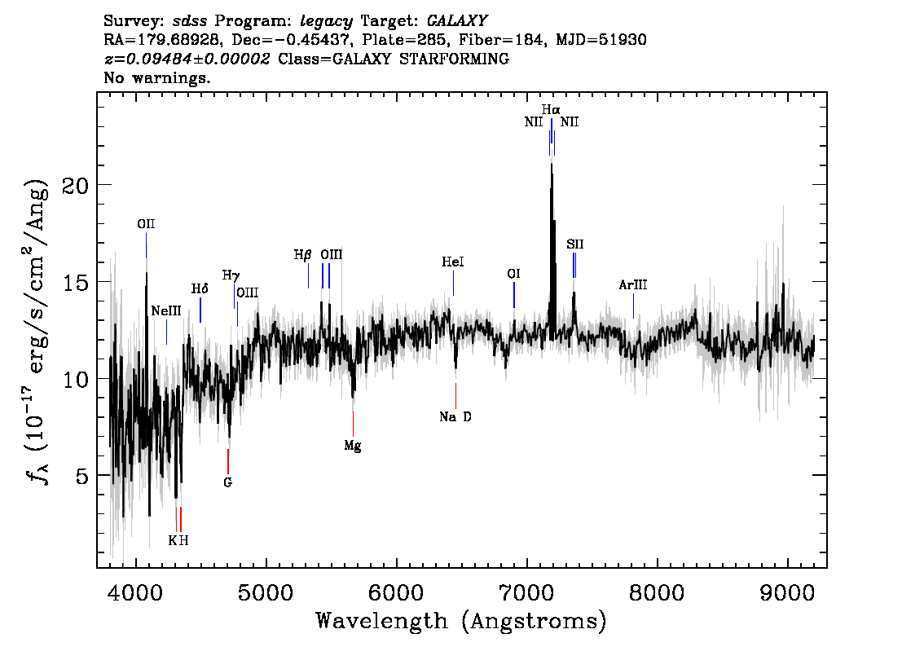
SDSS Spectra Data
Galaxy spectrum is a combination of millions of stars in the galaxy.
Each star has a unique pattern of peaks and valleys and these patterns can be grouped into “spectral type” of stars.
Tells us how much light is being emitted or absorbed at each wavelength.

Slide 12
Data Overview

Slide 13
Features
Features used in this project are:
Photometrics
Ratio between shorter and longer axis.
Magnitude on five bands (ugriz).
Spectrum
Spectrum Emission Line flux.
Axis: arcsec. Magnitude: nanomag/arcsec^2. Flux: 10⁻¹⁷ergs/cm²/s/A.
Notes:
Add to phases photometrics/spectral

Slide 14
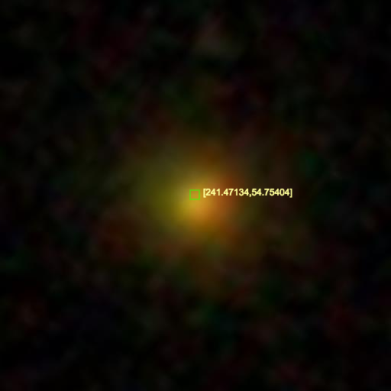
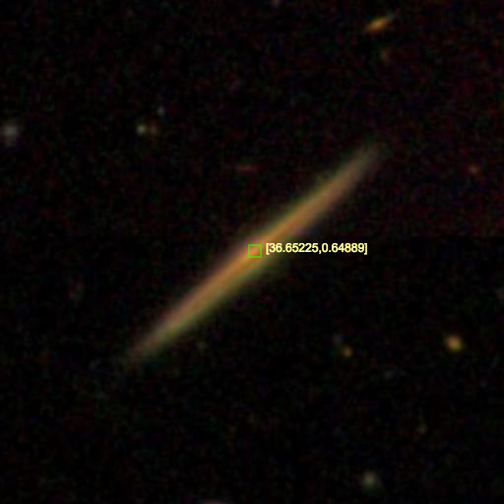
Axis Ratio (b/a ratio)
b/a ratio = 1
b/a ratio = 0.03
Notes:
expAB ratio influences the magnitude of one galaxy in our eye.

Slide 15
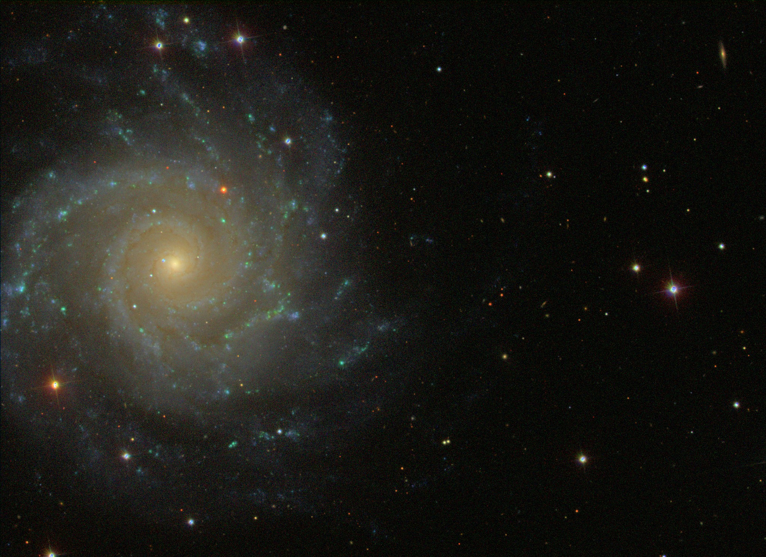
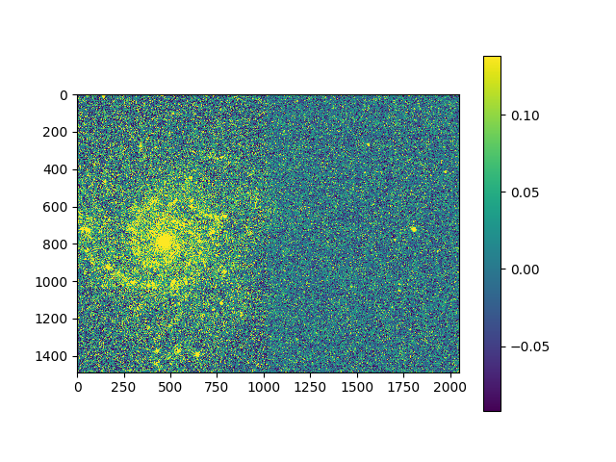
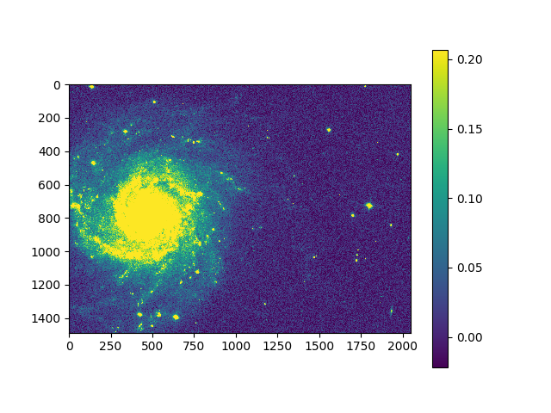
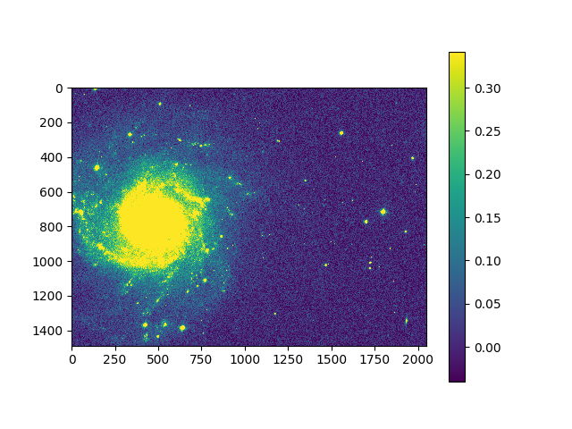
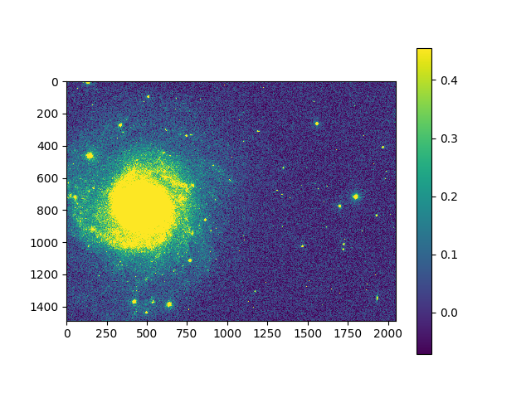
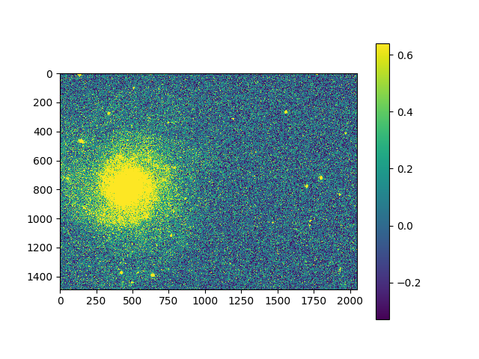
Messier 74
U band
Z band
G band
R band
I band

Slide 16
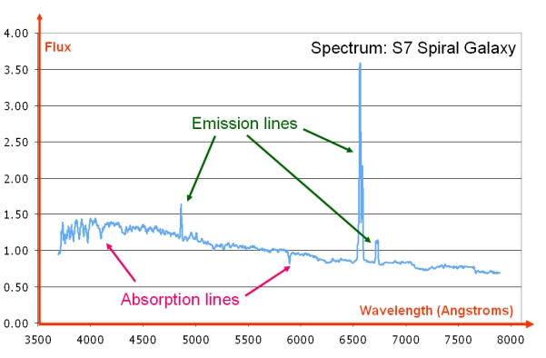
Spectrum Emission Fluxes
Spectrum
A set of fluxes on “fixed 28 emission lines for atoms”.
Notes:
We fit galaxies using an adaptation of the publicly available Gas AND Absorption Line Fitting (GANDALF, Sarzi et al. 2006) and penalised PiXel Fitting (pPXF, Cappellari & Emsellem 2004).
shifted.

Slide 17
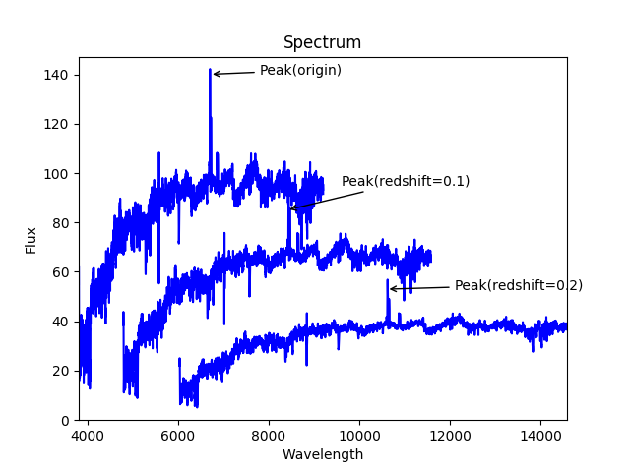
How the redshift influence our data?
As the same galaxy gets redshifted, not only does the spectrum move to the right, but the flux shrinks as well.

Slide 18

What are we looking for?
We want two sosies to be intrinsically similar
Engineer some features that are insensitive to distance changes.
Only find sosies that are in a distance range (redshift range)
Apparent Similarity
Intrinsic Similarity
Notes:
Redshift patterns
K-correction ()

Slide 19
Way Out
Find Sosies
Find Sosies in a distance range
Engineer distance-invariant features
Sosies inside a redshift bin
Take Ratios
Normalize Flux
Notes:
Connection to the previous work - no morphological type, which we do not have access to.

Slide 20
Methods & Results

Slide 21
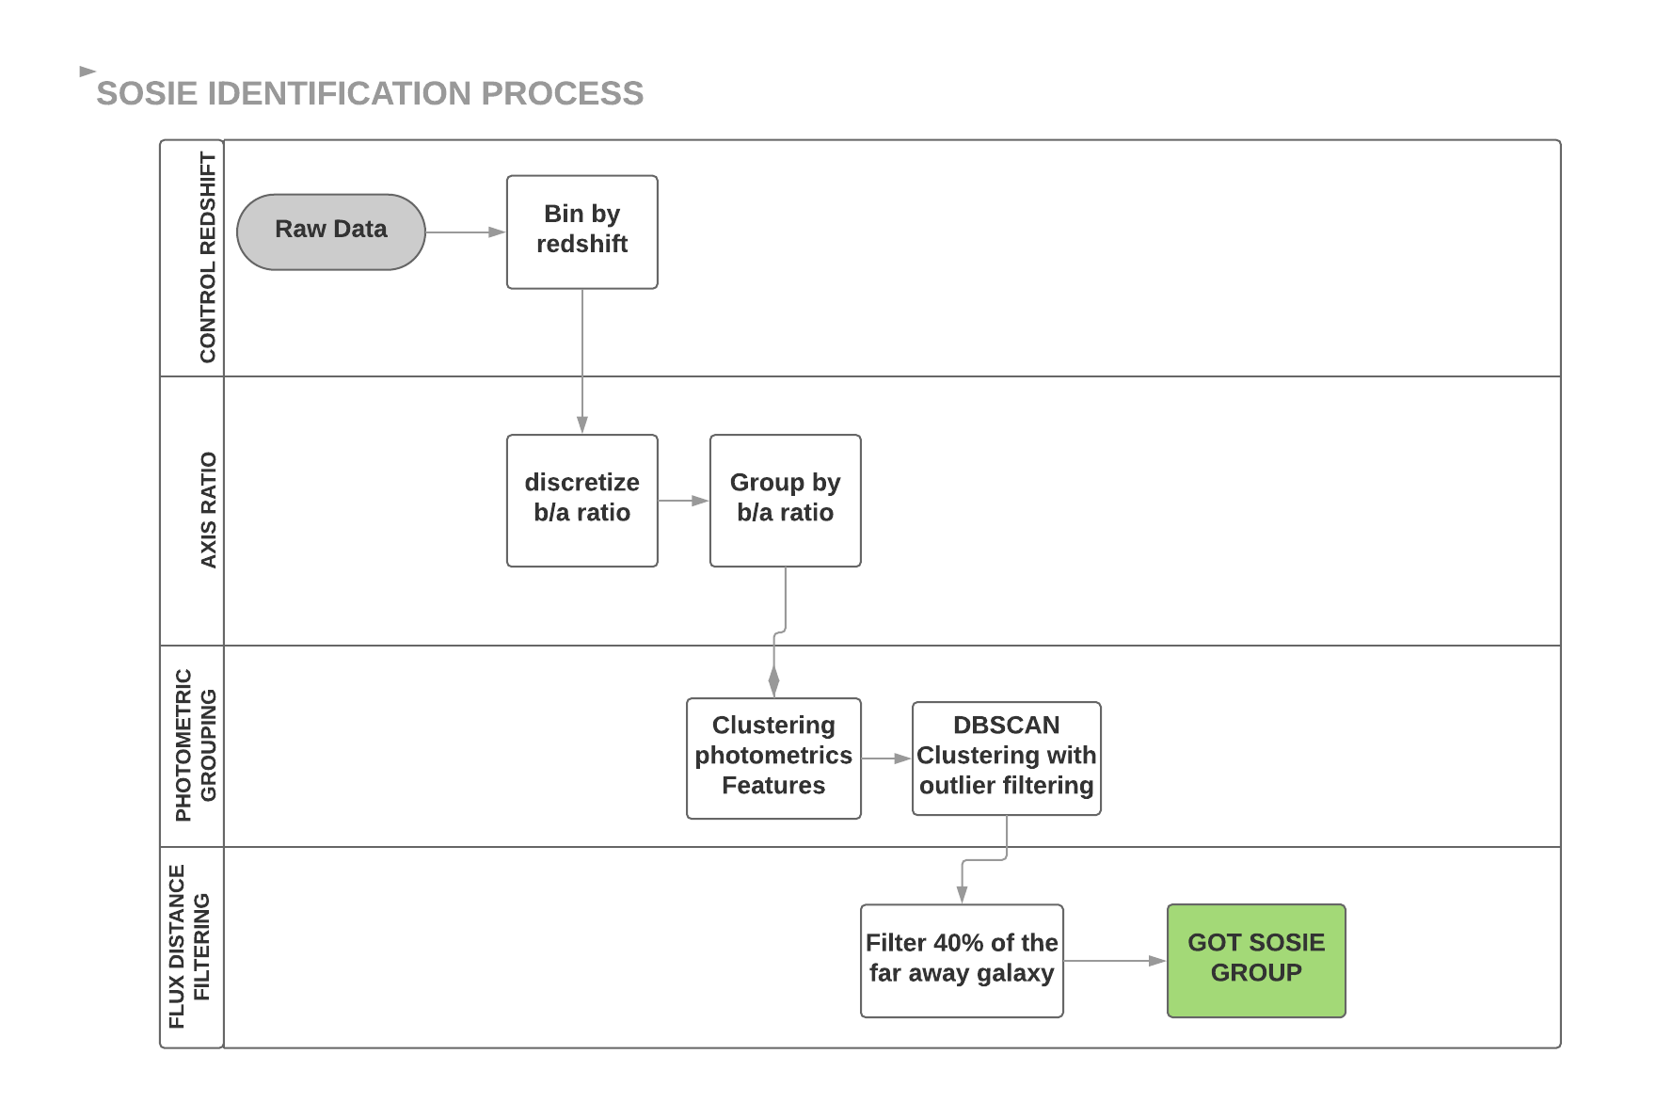

Slide 22
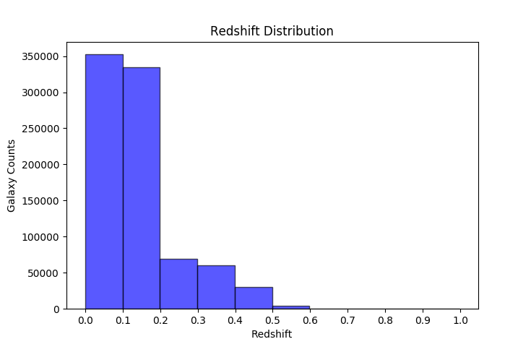
Redshift Bins
Sosie Identification Rule 1:
For a pair of galaxies to be Sosies, they have to be in the same bin.

Slide 23
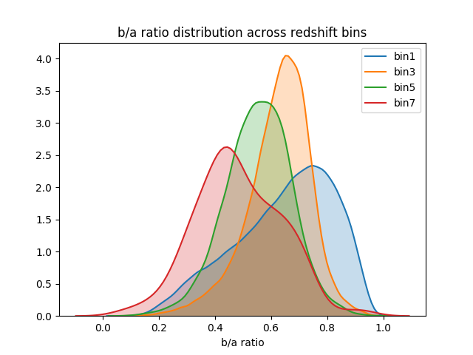
Redshift & b/a Ratio
Sosie Identification Rule 2:
For a pair of galaxies to be Sosies, they should have similar b/a ratio.
Notes:
b/a

Slide 24
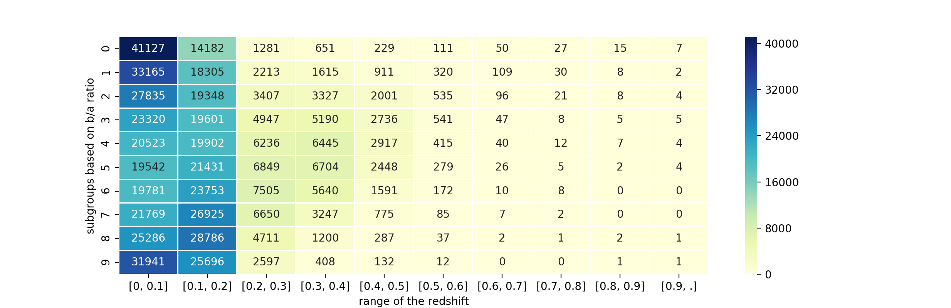
A Grid Partition
Notes:
Review comparing galaxies in each group, not face on with

Slide 25
100 groups
In each group

Slide 26
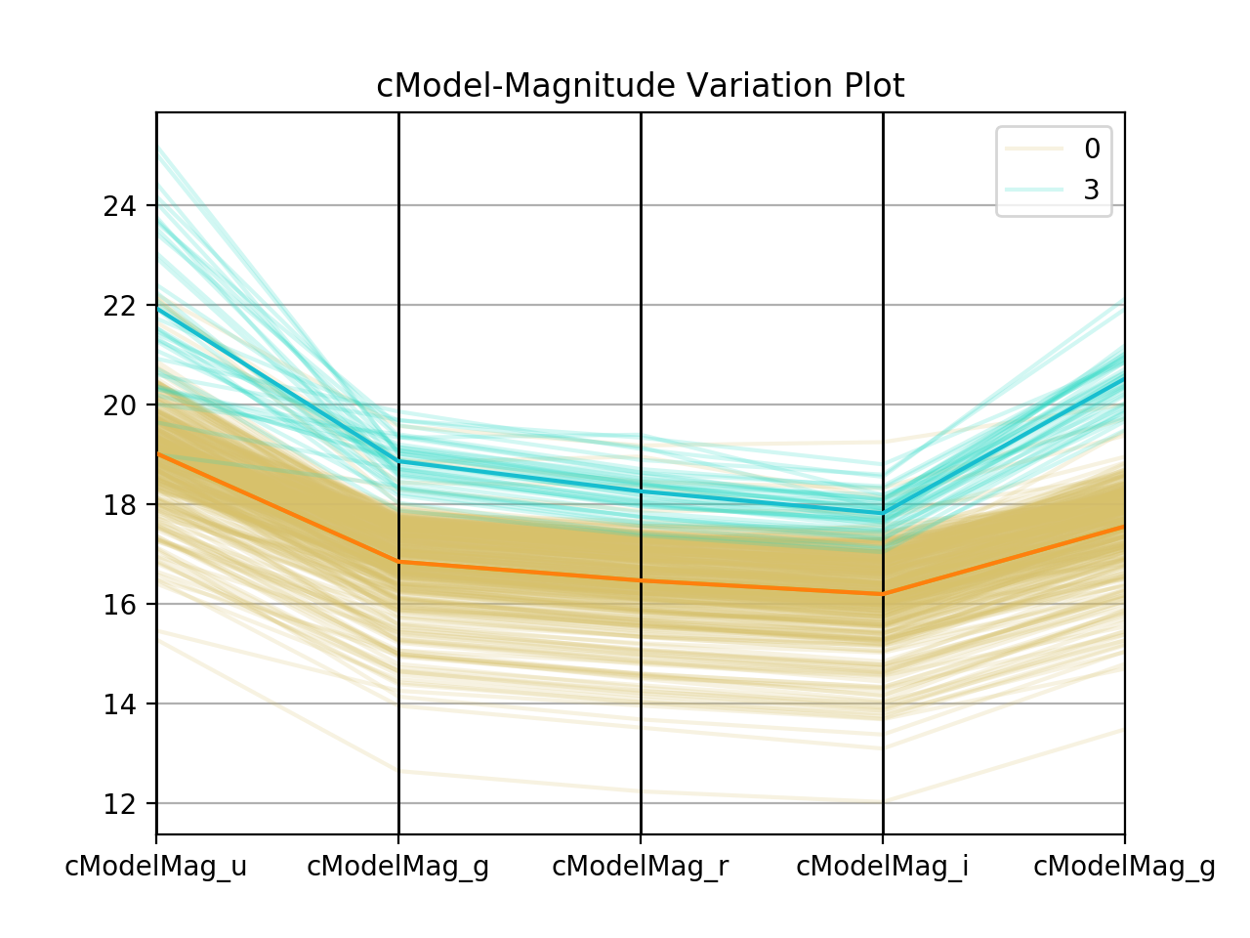
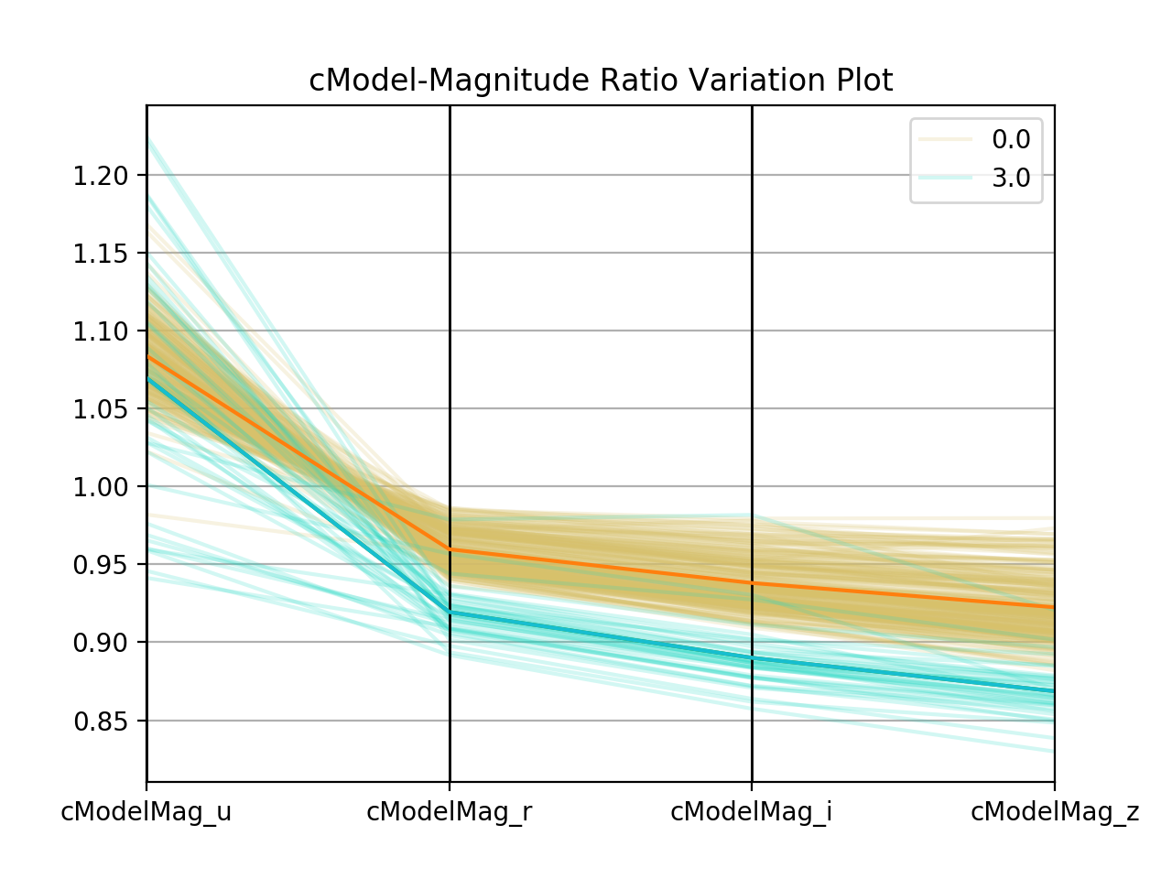
Photometric Variables
Why we need ratio of the cModel Magnitude feature?
0.1
0.3
1
4
z

Slide 27
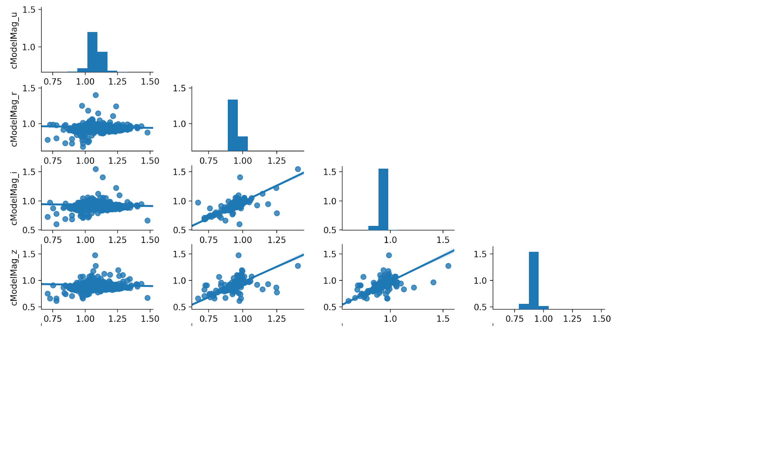
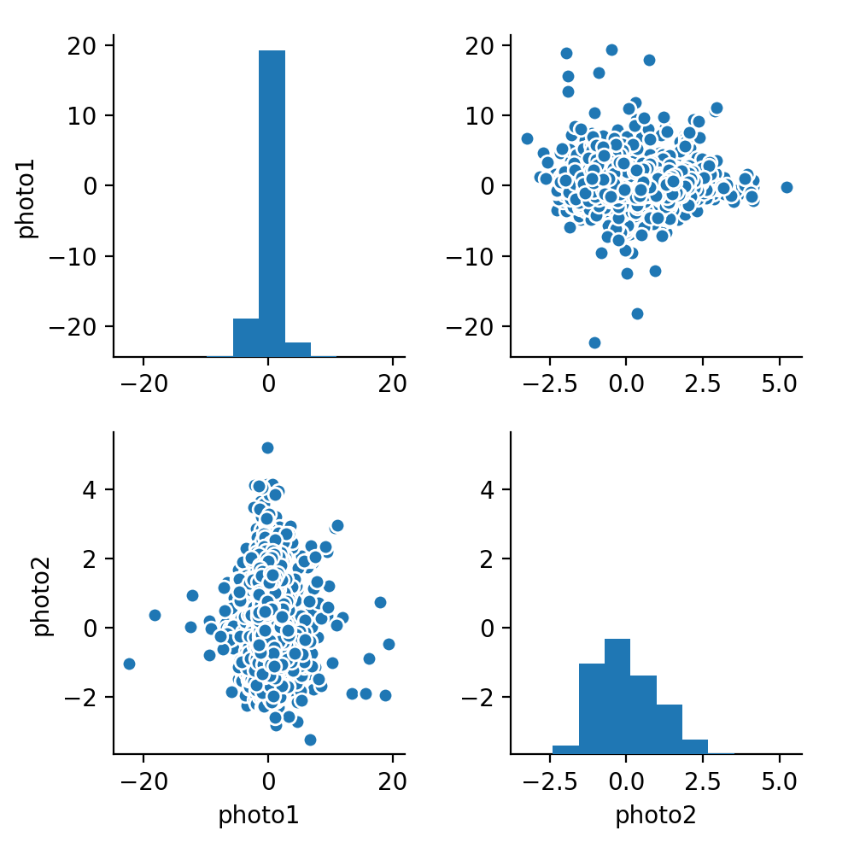
cModel Magnitude Ratio at different bands
cModelMag_u cModelMag_r cModelMag_i cModelMag_z
Before PCA After PCA
Notes:
Magnitude/ high correlation: After the transformation- cModel_variation
take ratio/ still high correlation/ PCA 2 components.

Slide 28
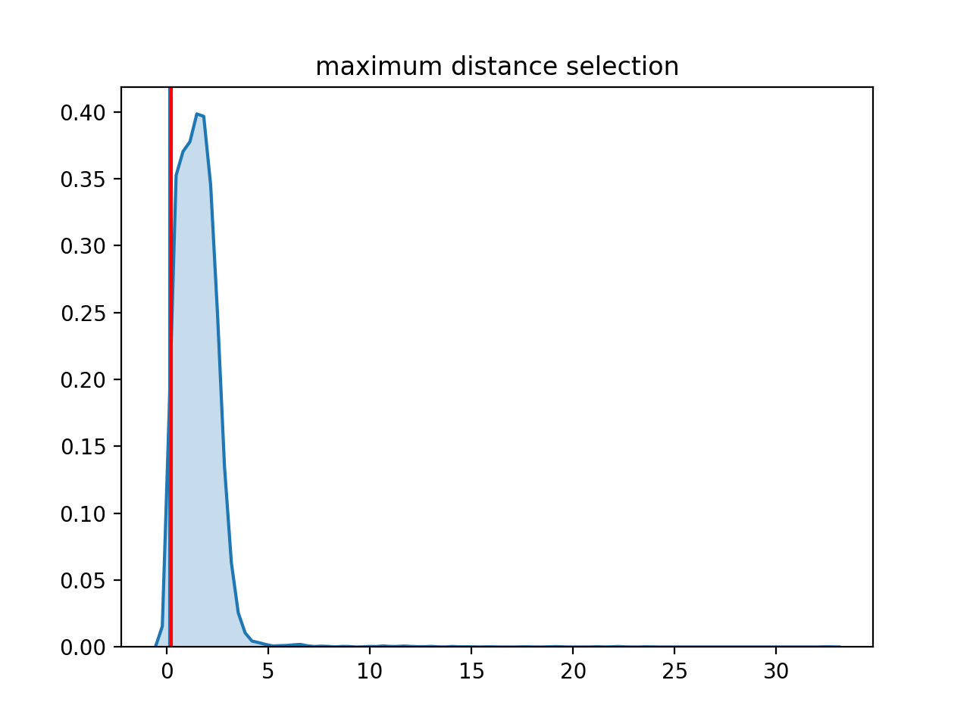
Clustering
Sosie Identification Rule 3:
For a pair of galaxies to be Sosies, they have to be in the same clusters generated by appropriate photometrics features.
Density-based spatial clustering of applications with noise(DBSCAN) allows us to specify a maximum feature distance (eps) for sosies in each cluster.
We chose 1% percentile of the pairwise euclidean distances of PC1 and PC2 as eps

Slide 29
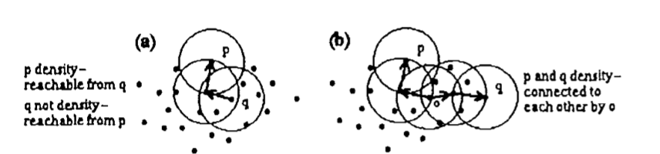
DBSCAN Demonstration
Start with a galaxy,
If there are >= 1 galaxy close to it, it is a core point in clustering.
Move galaxies that are close enough to one core into that cluster. Core points will be updated throughout the clustering process.
Advantages:
“Noise point” (points have no D(neighbours) < eps) will be excluded from any clusters.
Clusters will be much denser than in other algorithms
 | Cited from: Ester, M., H. P. Kriegel, J. Sander, and X. Xu, "A Density-Based Algorithm for Discovering Clusters in Large Spatial Databases with Noise

Slide 30
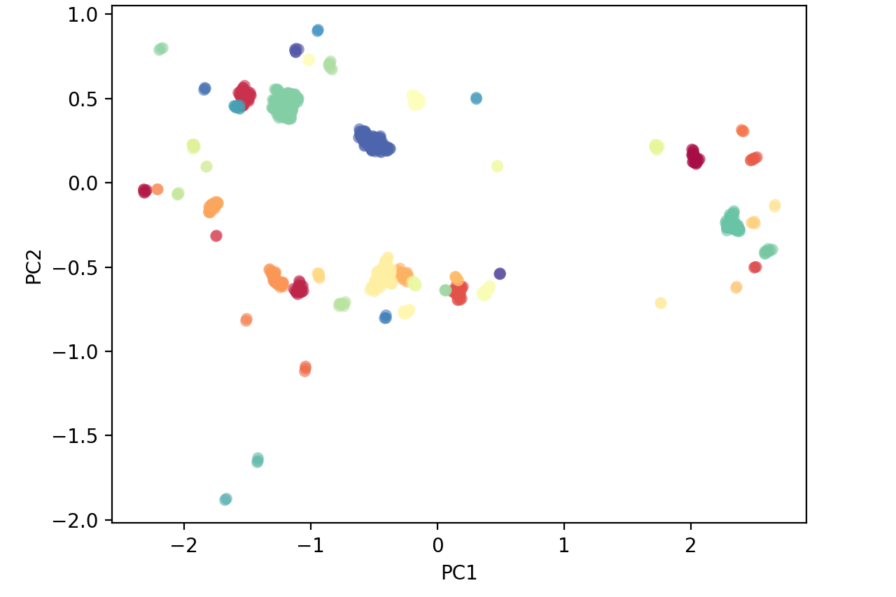
DBSCAN Demonstration
Sample Clusters (50 clusters) in 1st Redshift bin and 1st B/A Ratio Group

Slide 31
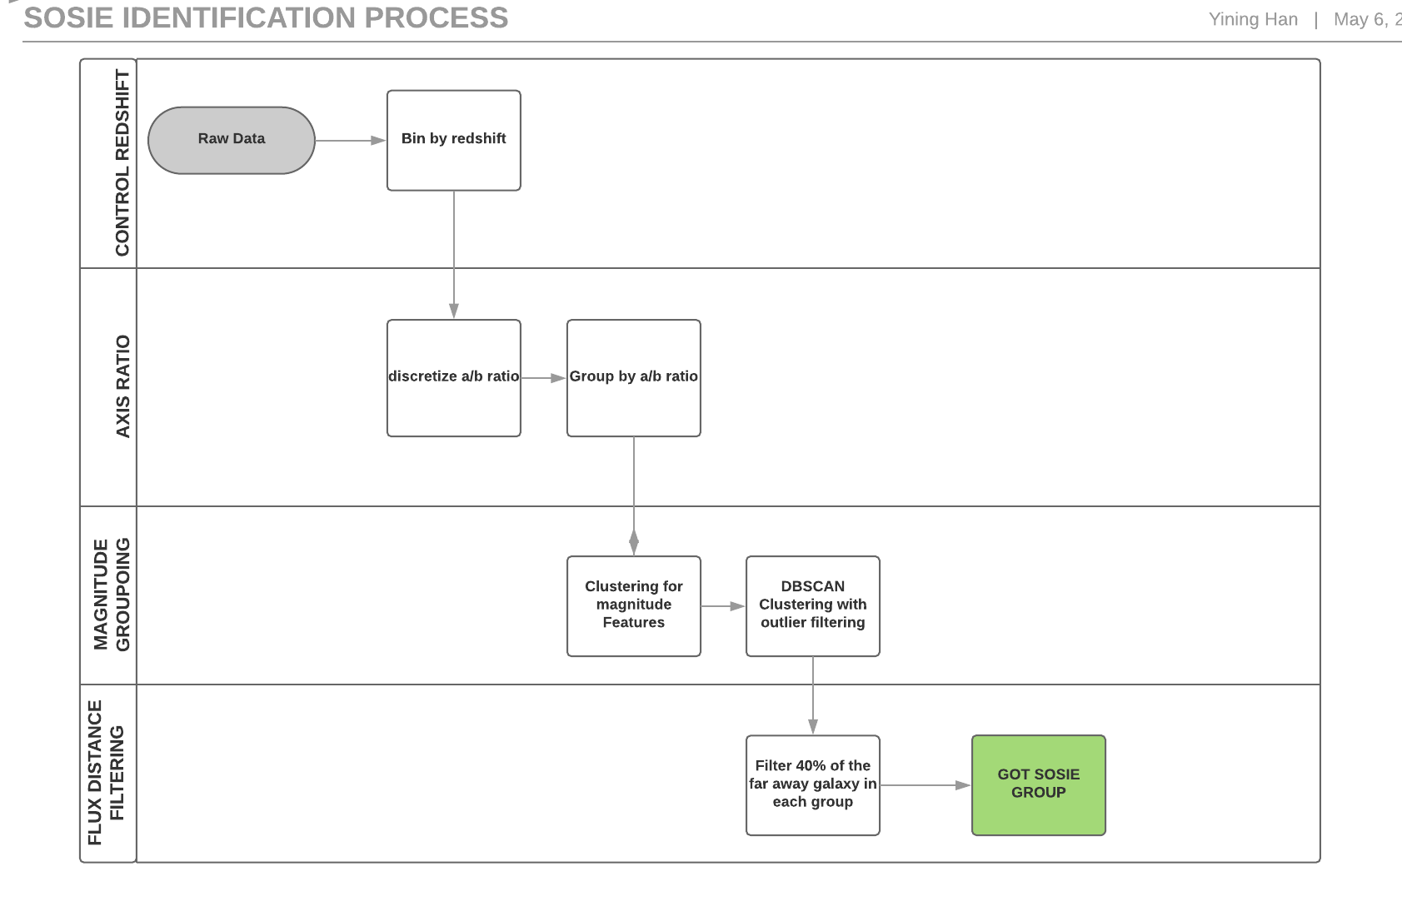

Slide 32
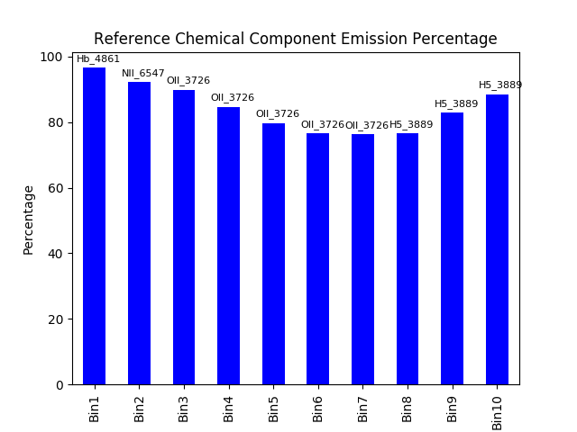
Spectral Emission Flux
Sosie Identification Rule 4:
For a pair of galaxies to be Sosies, they have to have similar set of “emission flux ratio” (Defined as Emission Fluxes / Reference Fluxes)
Redshift Bins

Slide 33
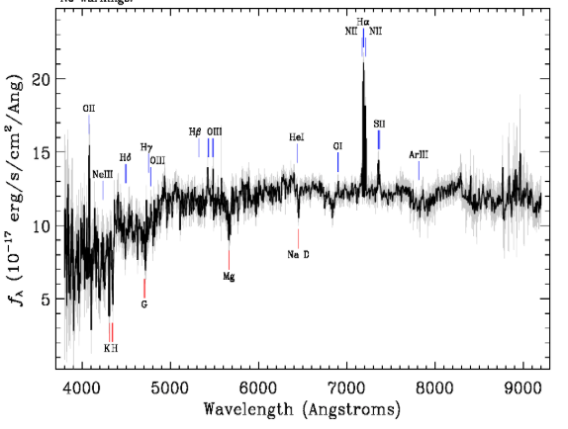
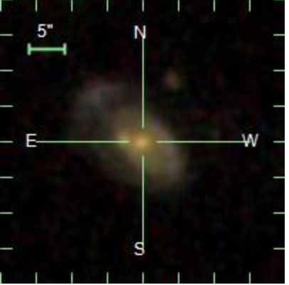
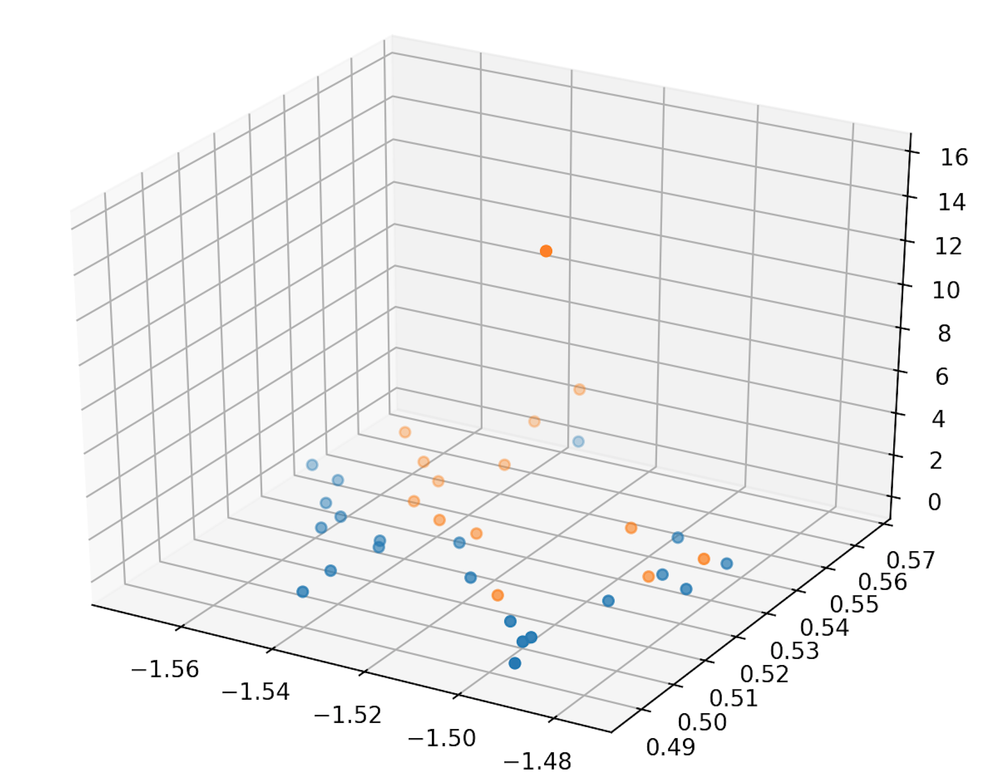
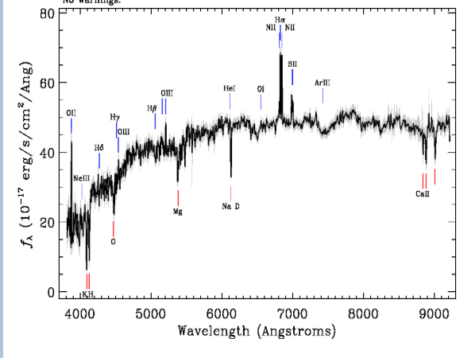
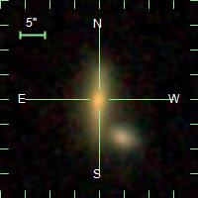
Filter through emission-line flux feature distance
One cluster in group(1, 1)
Distance
PC2
PC1
Notes:
We have groups of galaxies that are similar in all of the features we have so far but we want to make sure that those whose emission line exceed the ranges of the detection patterns, we exlude them.

Slide 34
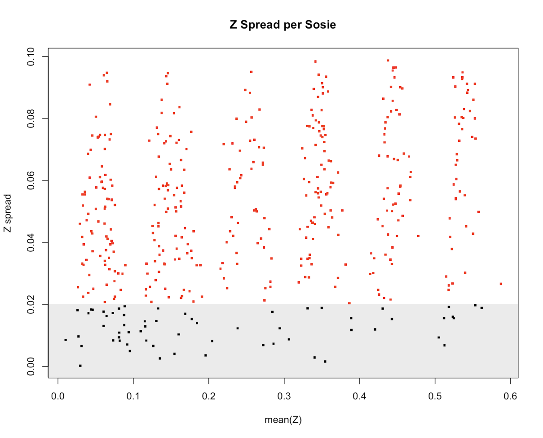
Maximum emission spectral feature distance
Z Spread Per Sosie Group
Sosie Identification Rule 5:
Sosies should be at least some distances apart to be considered an effective Sosie!
Final results: 737 clusters of sosies were found across 100 bins.
Effective
Not Effective

Slide 35
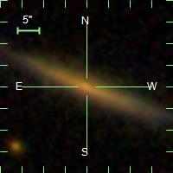
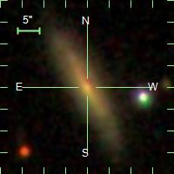
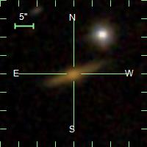
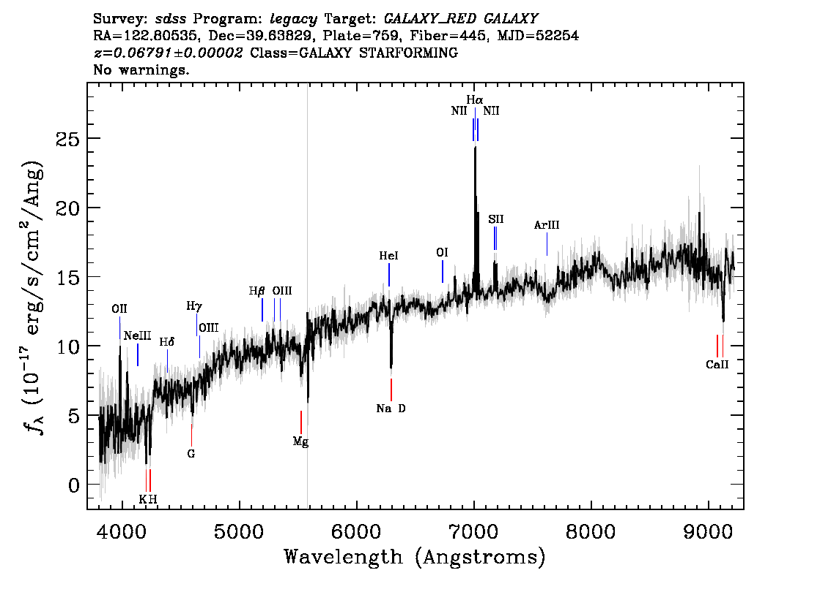
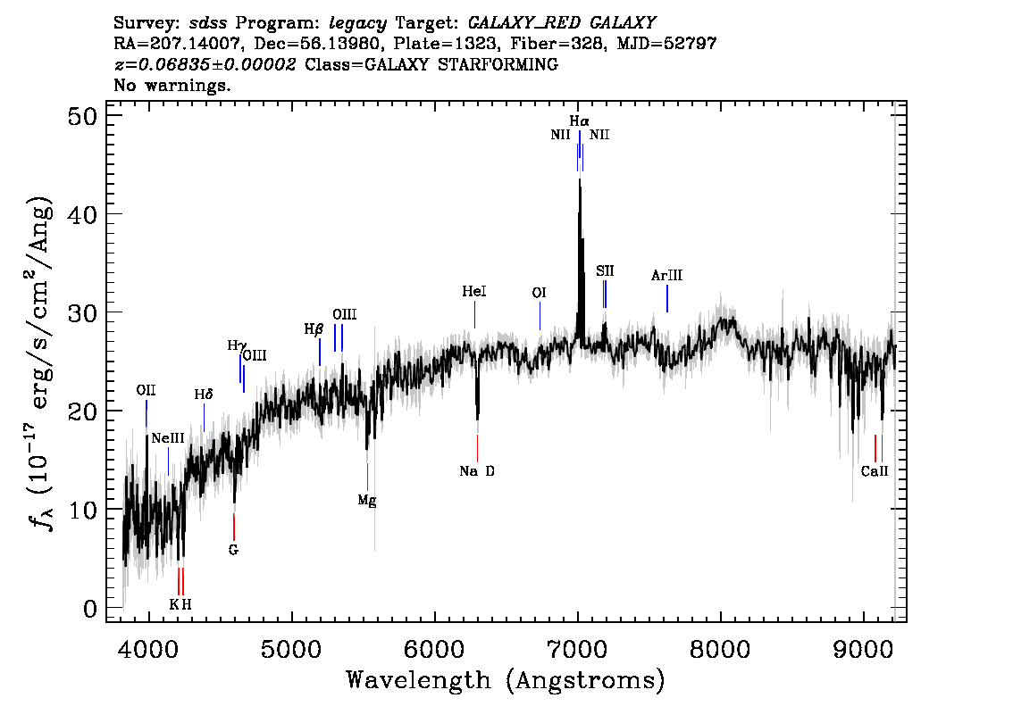
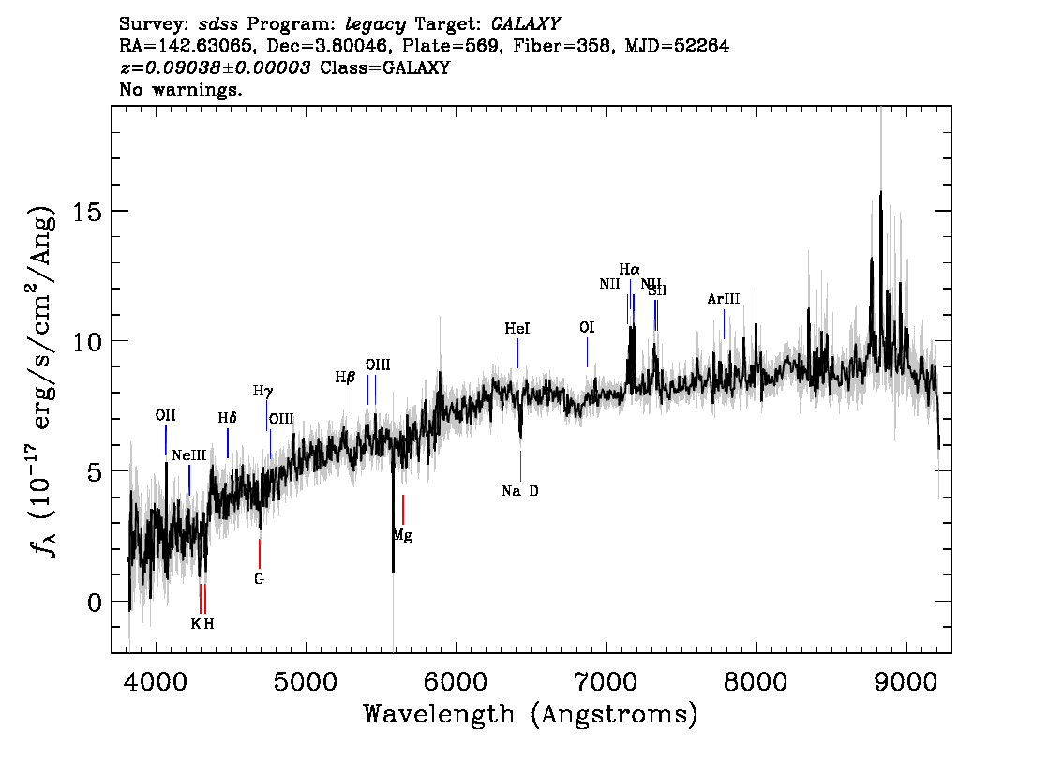
Sosie (b/a ratio group 1 & Redshift group 1)
Z=0.068
Z=0.068
Z=0.090

Slide 36
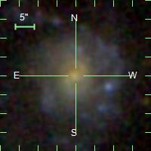
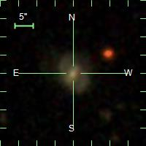
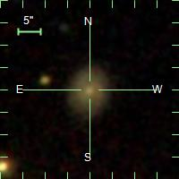
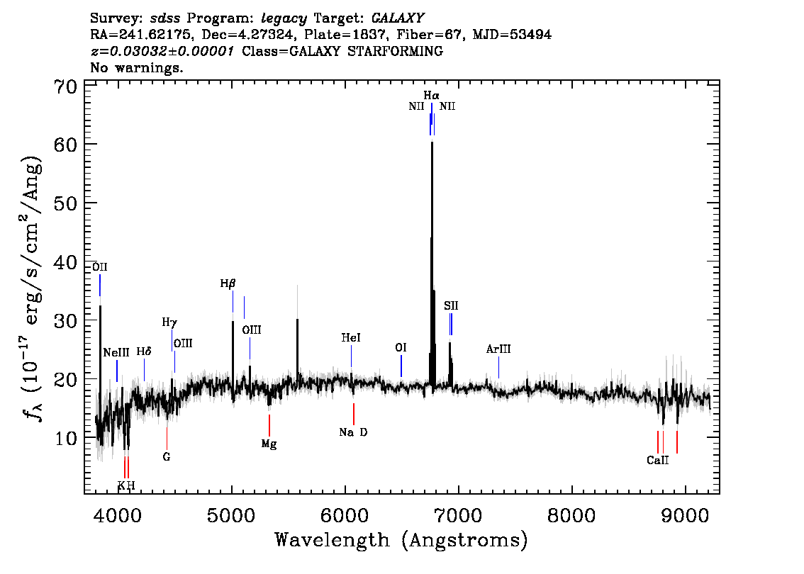
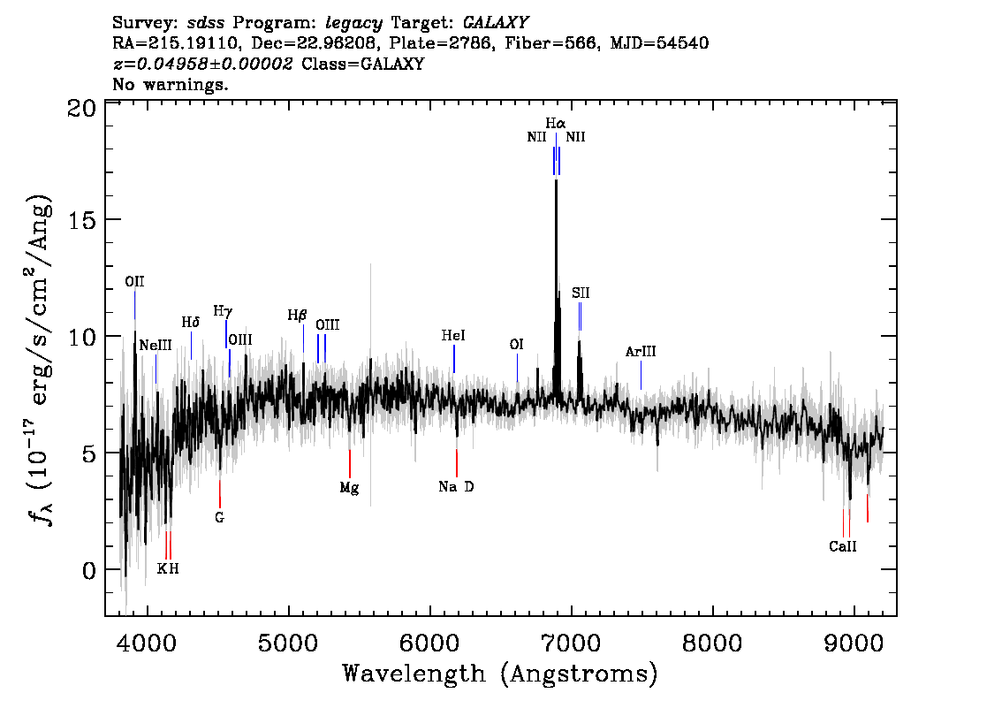
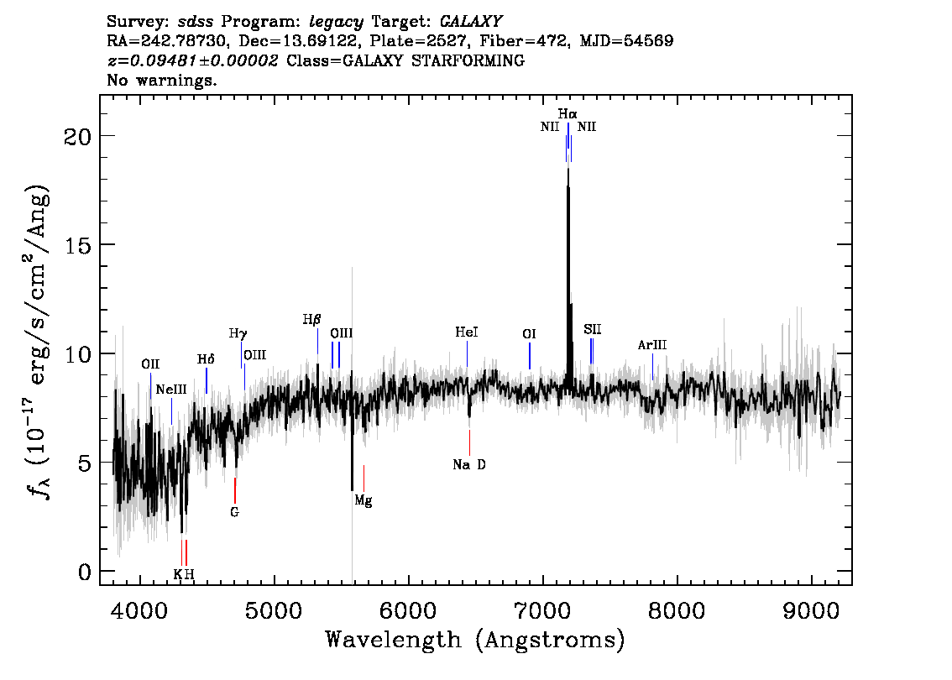
Sosie (b/a ratio group9 & Redshift group1)
Z=0.03
Z=0.049
Z=0.095

Slide 37
Review of Pipeline
Bin Raw Data by Redshift
Bin by AB Ratio
Cluster Photometric Features
Filter galaxies to get Sosies
Get effective Sosies
For galaxies to be look-alikes, they have to be in the same redshift bin
Bin AB Ratio data first by redshift then divide into subgroups.
Grouping by AB ratio resulted into 100 groups
For galaxies to be look-alikes, they should have a similar AB ratio
Per each group, we run clustering and for a pair of galaxies to be sosies, they have to be in the same cluster.
To make distance robust, we divide by the reference chemical component that appears most frequently in each bin
Any galaxy whose emission lines exceed the range of the detection patterns in each cluster are excluded
To be effective sosies, galaxies should be at a certain range of redshift apart.
Notes:
We have groups of galaxies that are similar in all of the features we have so far but we want to make sure that those whose emission line exceed the ranges of the detection patterns, we exlude them.

Slide 38
Limitations and Further Steps
Find the morphological type of each galaxy
Add more features to the dataset
Calculate the Hubble Constant from the distance ratio

